Slide 1

CS654: Digital Image Analysis
Lecture 30: Color Model Conversion

Slide 2
Recap of Lecture 29
Color image processing
Fundamentals of colors
Primary and secondary colors (light and pigment)
Color models

Slide 3
Outline of Lecture 30
HSI Model
Conversion from HIS → RGB, RGB→ HIS
Pseudo color image processing
Application
Image processing techniques on color images

Slide 4
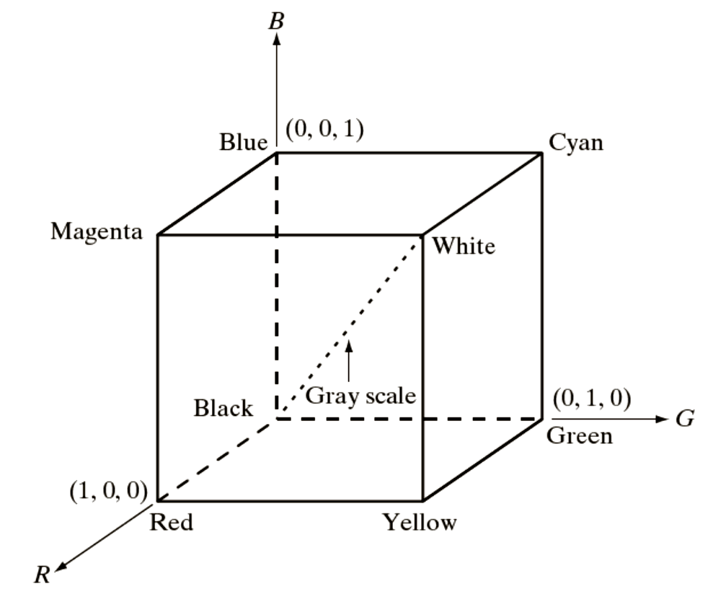
Color Models
Images: Gonzalez & Woods, 3rd edition

Slide 5
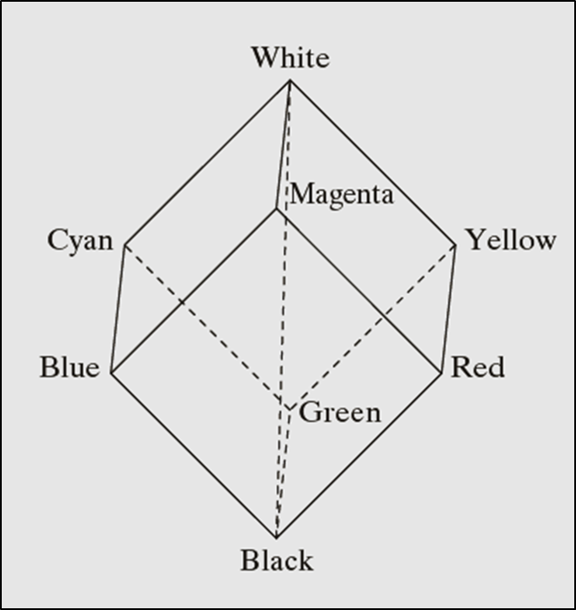
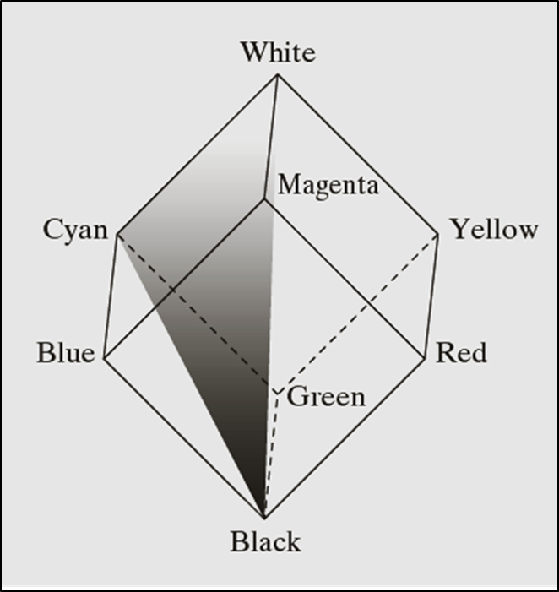
The HSI Color Models
Images: Gonzalez & Woods, 3rd edition

Slide 6
Color model conversion

Slide 7
Color model conversion
Intensity (I)
Saturation (S)

Slide 8
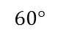
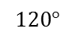
Color model conversion
$$120°$$
$$60°$$

Slide 9
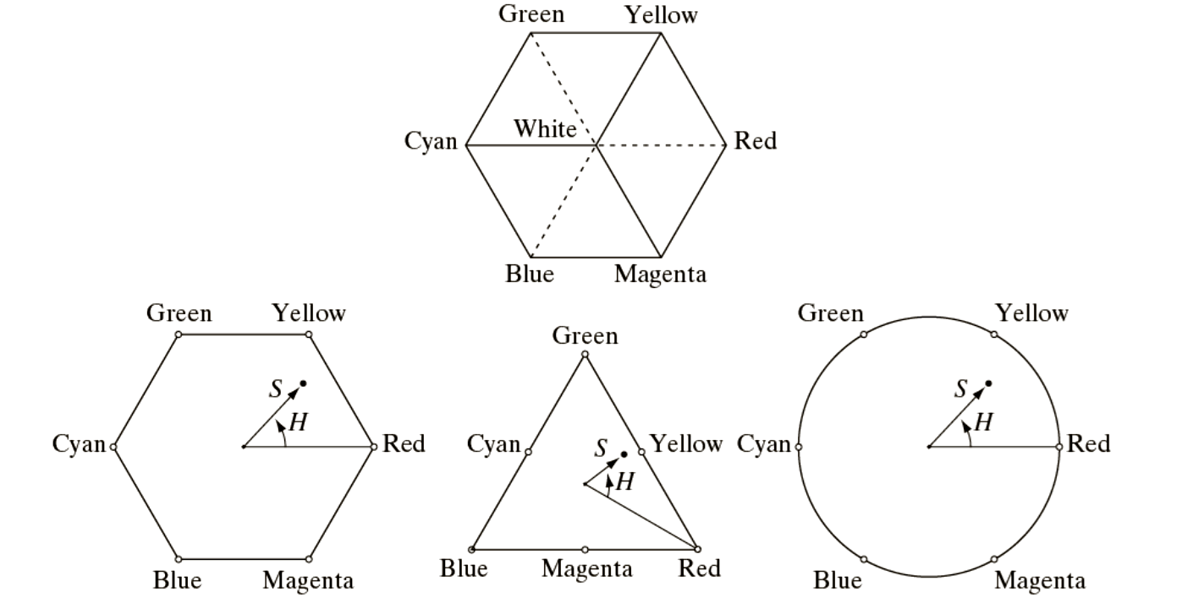
Convert RGB to HSI

Slide 10
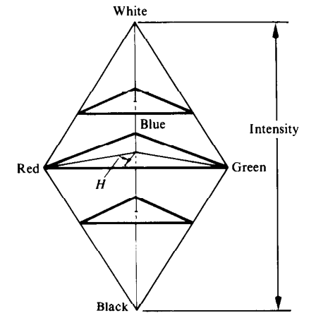
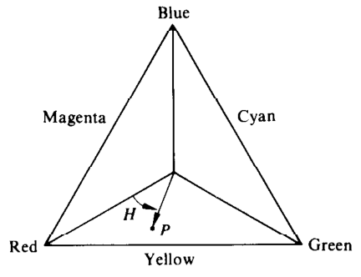
HSI to RGB Conversion
HIS Color triangle
HIS Color solid

Slide 11
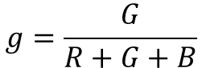
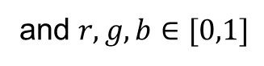
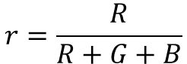
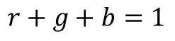
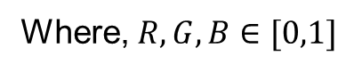
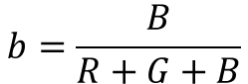
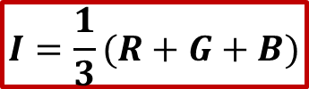
HSI model color representation
RGB primaries
$$r=\frac{R}{R+G+B}$$
$$g=\frac{G}{R+G+B}$$
$$b=\frac{B}{R+G+B}$$
Where, $R,G,B∈[0,1]$
Also
$$r+g+b=1$$
and $r,g,b∈[0,1]$
For any $R,G,B$value the intensity component $(I)$ is given by
$$I=\frac{1}{3}(R+G+B)$$

Slide 12
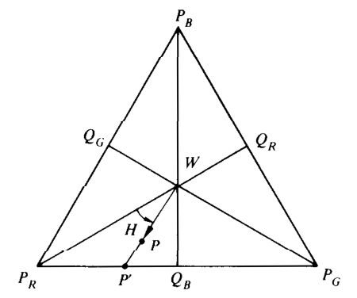
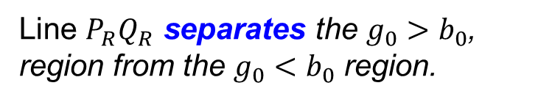
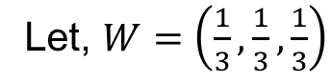
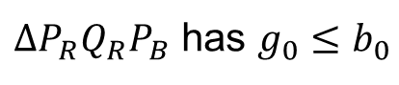
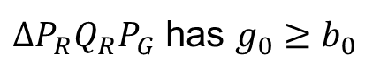
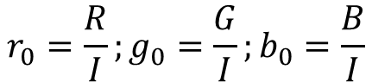
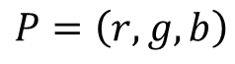
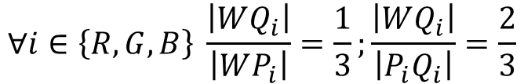
Calculation of Hue (H)
Let, $W=\left(\frac{1}{3},\frac{1}{3},\frac{1}{3}\right)$
$$P=\left(r,g,b\right)$$
$$r_{0}=\frac{R}{I};g_{0}=\frac{G}{I};b_{0}=\frac{B}{I}$$
$∆P_{R}Q_{R}P_{G}$ has $g_{0}≥b_{0}$
BR
GB
$∆P_{R}Q_{R}P_{B}$ has $g_{0}≤b_{0}$
RG
Line $P_{R}Q_{R}$ separates the $g_{0}>b_{0}$, region from the $g_{0}<b_{0}$ region.
$$∀i∈\left\{R,G,B\right\} \frac{\left|WQ_{i}\right|}{\left|WP_{i}\right|}=\frac{1}{3};\frac{\left|WQ_{i}\right|}{\left|P_{i}Q_{i}\right|}=\frac{2}{3}$$

Slide 13
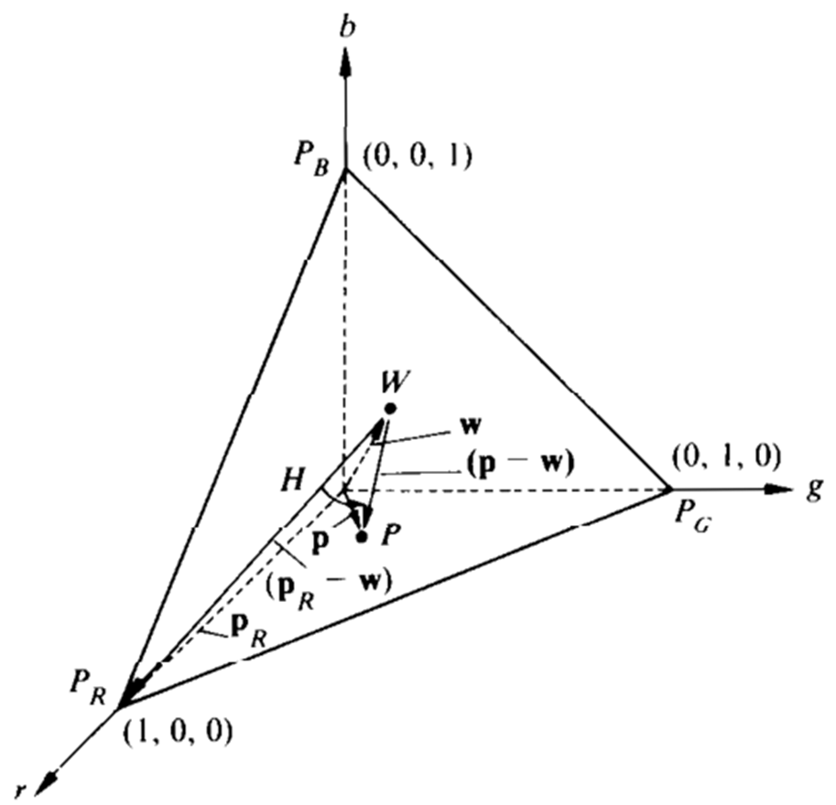
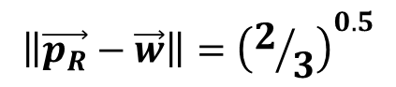
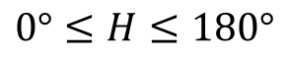
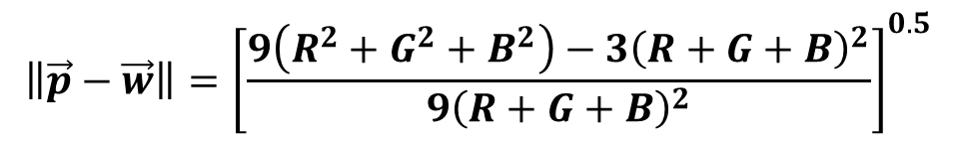
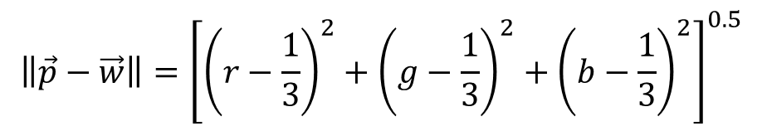

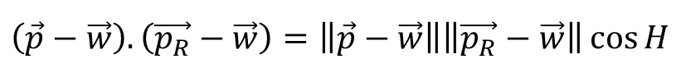
Calculation of Hue
$$0°≤H≤180°$$
$$\left(\vec{p}−\vec{w}\right).\left(\vec{p_{R}}−\vec{w}\right)=\left\|\vec{p}−\vec{w}\right\|\left\|\vec{p_{R}}−\vec{w}\right\|\cos{H}$$
Where, $H$= Hue
$$\left\|\vec{p}−\vec{w}\right\|={\left[{\left(r−\frac{1}{3}\right)}^{2}+{\left(g−\frac{1}{3}\right)}^{2}+{\left(b−\frac{1}{3}\right)}^{2}\right]}^{0.5}$$
$$\left\|\vec{p}−\vec{w}\right\|={\left[\frac{9\left(R^{2}+G^{2}+B^{2}\right)−3{\left(R+G+B\right)}^{2}}{9{\left(R+G+B\right)}^{2}}\right]}^{0.5}$$
$$\left\|\vec{p_{R}}−\vec{w}\right\|={\left(2/3\right)}^{0.5}$$

Slide 14
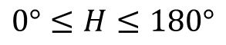

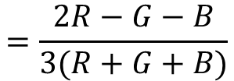
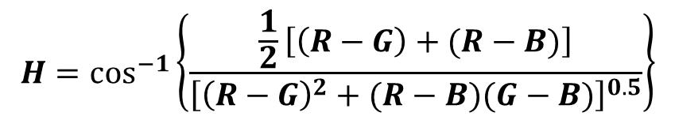
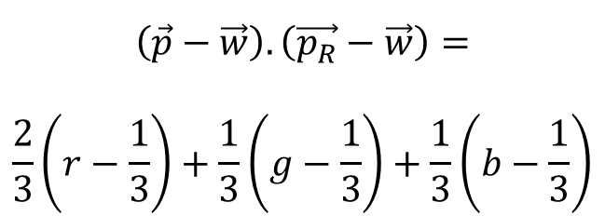
Calculation of Hue
$$0°≤H≤180°$$
$$\left(\vec{p}−\vec{w}\right).\left(\vec{p_{R}}−\vec{w}\right)=$$
$$\frac{2}{3}\left(r−\frac{1}{3}\right)+\frac{1}{3}\left(g−\frac{1}{3}\right)+\frac{1}{3}\left(b−\frac{1}{3}\right)$$
$$=\frac{2R−G−B}{3(R+G+B)}$$
$$H=\cos^{−1}\left\{\frac{\frac{1}{2}\left[\left(R−G\right)+(R−B)\right]}{{\left[{\left(R−G\right)}^{2}+(R−B)(G−B)\right]}^{0.5}}\right\}$$
If $b_{0}>g_{0}$ then $H=360°−H$

Slide 15
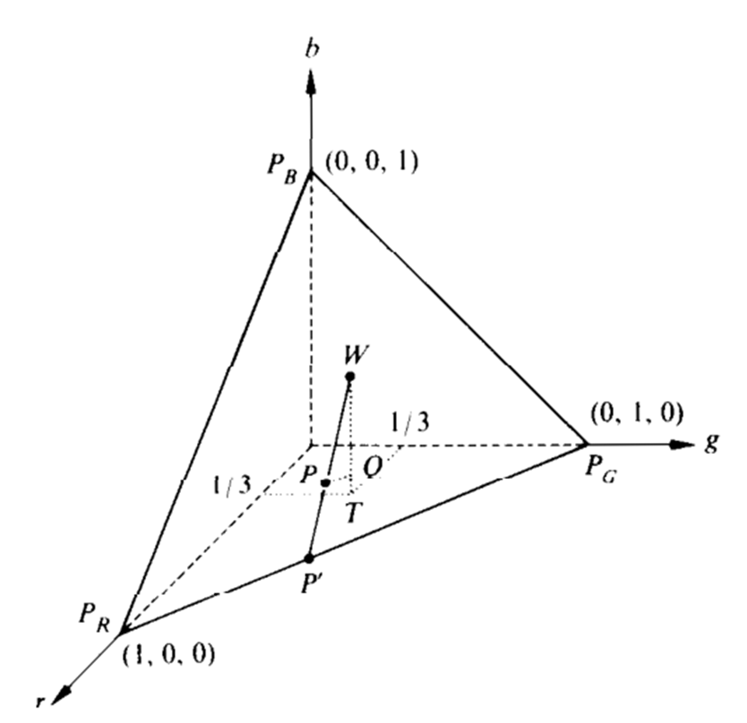
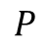
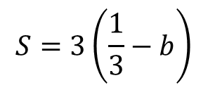
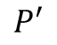


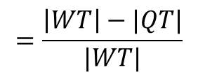

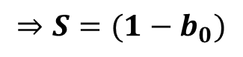
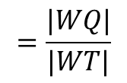
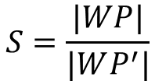
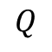
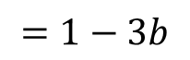
Calculation of Saturation (S)
$$W$$
$$\frac{1}{3}$$
$$Q$$
$$S=\frac{|WP|}{|WP^{′}|}$$
$$=\frac{|WQ|}{|WT|}$$
$$=\frac{\left|WT\right|−|QT|}{|WT|}$$
$$P$$
$$T$$
$$S=3\left(\frac{1}{3}−b\right)$$
$$=1−3b$$
$$⇒S=(1−b_{0})$$
$$P′$$

Slide 16
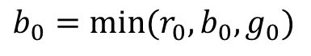
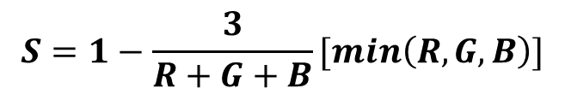
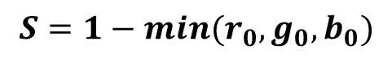
Calculation of S
In the RG sector
$$b_{0}=\min{(r_{0},b_{0},g_{0})}$$
$$S=1−min(r_{0},g_{0},b_{0})$$
$$S=1−\frac{3}{R+G+B}[min\left(R,G,B\right)]$$
RG

Slide 17
The HSI Color Models
Converting colors from RGB to HSI

Slide 18
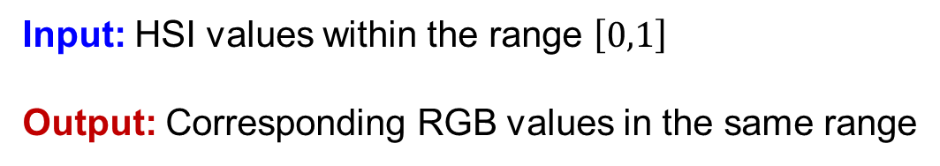
Converting colors from HSI to RGB
Input: HSI values within the range $\left[0,1\right]$
Output: Corresponding RGB values in the same range
BR
GB
RG

Slide 19
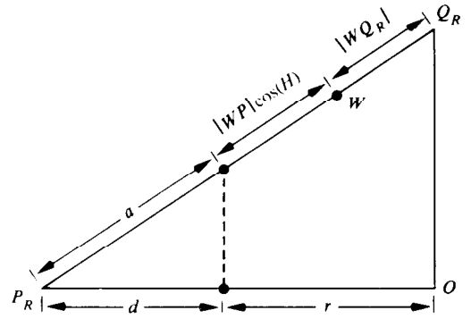
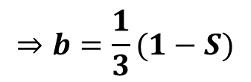
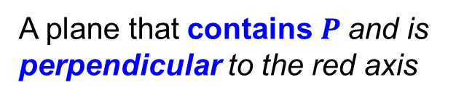


Saturation calculation: RG region
$$⇒b=\frac{1}{3}(1−S)$$
We know that $S=1−3b$
A plane that contains $P$and is perpendicular to the red axis
Value of $r$ is the projection of $P$onto the red axis

Slide 20






Saturation calculation: RG region
From similar triangles,
$$\frac{\left|P_{R}Q_{R}\right|}{\left|P_{R}O\right|}=\frac{a}{d}$$
$$∴d=1−r;$$
$$a={|P}_{R}Q_{R}|−\left(\left|WP\right|\cos\left(H\right)+|WQ_{R}|\right)$$
$$r=\frac{|WQ_{R}|}{{|P}_{R}Q_{R}|}+\frac{\left|WP\right|}{{|P}_{R}Q_{R}|}\cos\left(H\right)$$
$$=\frac{1}{3}+\frac{\left|WP\right|}{{|P}_{R}Q_{R}|}\cos\left(H\right)$$
$$1$$

Slide 21







Saturation calculation: RG region
$$r=\frac{1}{3}+\frac{\left|WP\right|}{{|P}_{R}Q_{R}|}\cos\left(H\right)$$
$$\left|WP\right|=S|WP^{′}|$$
Angle formed at $W$ by line segments $P_{R}Q_{R}$ and $WQ_{B}$ is $60°$
$$\left|WQ_{B}\right|=\left|WP^{′}\right|\cos{(60°−H)}$$
$$\left|WP^{′}\right|=\left|WQ_{B}\right|/\cos\left(60°−H\right)$$
$$r=\frac{1}{3}+\frac{S\left|WQ_{B}\right|}{{|P}_{R}Q_{R}|\cos\left(60°−H\right) }\cos\left(H\right)$$
$$⇒r=\frac{1}{3}\left(1+\frac{S\cos\left(H\right)}{\cos\left(60°−H\right) }\right)$$

Slide 22

HSI to RGB: RG Sector
$$120°$$

Slide 23

HSI to RGB: GB Sector
$$120°$$

Slide 24
HSI to RGB: BR Sector
$$120°$$

Slide 25

The HSI Color Models

Slide 26


The HSI Color Models
RGB
H
H
S
S
I
I
RGB

Slide 27
Pseudocolor Image Processing
False color processing
Assigning colors to gray values based on a specified criterion.
Human visualization and interpretation of gray-scale events in an image or sequence of images.

Slide 28


Intensity Slicing

Slide 29

Intensity Slicing : Example

Slide 30

Intensity Slicing : Example

Slide 31

Gray Level to Color Transformations

Slide 32

Gray Level to Color Transformations

Slide 33

Gray Level to Color Transformations

Slide 34

Gray Level to Color Transformations

Slide 35


Pseudocolor: example
A grayscale MRI of a knee
A pseudocolor MRI of a knee created using three different grayscale scans

Slide 36
Basic of Full Color Image Processing
Let c represent an arbitrary vector in RGB color space
For an image of size M*N,

Slide 37

Basic of Full Color Image Processing

Slide 38
Basic of Full-Color Image Processing
Major categories of full-color Image processing:
Per-color-component processing
Vector-based processing

Slide 39
Color Transformation
Processing the components of a color image within the context of a single color model.
Color components of g
Color components of f
Color mapping functions

Slide 40

Color Transformation: Example
CMYK
RGB
Some difficulty in interpreting the HUE:
Discontinuity where 0 and 360º meet.
Hue is undefined for a saturation 0
HSI

Slide 41

Color Transformation: Modify the Intensity

Slide 42

Color Complement

Slide 43

Color Complement: Example

Slide 44
Tone and Color Correction
The tonal range of an image, also called its key-type, refers to its general distribution of color intensities.
High-key images: Most of the information is concentrated at high intensities.
Low-key images: Most of the information is concentrated at low intensities.

Slide 45

Tonal correction: Example
Middle-key Image

Slide 46

Tonal correction: Example
High-key Image

Slide 47

Tonal correction: Example
Low-key Image

Slide 48

Color correction
The proportion of any color can be increased by decreasing the amount of the opposite (or complementary) color in the image or by raising the proportion of the two immediately adjacent colors or decreasing the percentage of the two colors adjacent to the complement.
Magenta ⬇
Removing Red and Blue
Adding Green

Slide 49

Color correction

Slide 50

Histogram Processing
Histogram Equalizing the Intensity
Saturation Adjustment

Slide 51
Color Image Smoothing
Averaging:

Slide 52

Color Image Smoothing
Red
Green
Blue

Slide 53

Color Image Smoothing
Hue
Saturation
Intensity

Slide 54

Color Image Smoothing
Averaging R,G and B
Averaging Intensity
Difference

Slide 55
Color Image Sharpening
The Laplacian of Vector c :

Slide 56

Color Image Sharpening: Example
Sharpening R,G and B
Sharpening Intensity
Difference

Slide 57
Thank you
Next Lecture: Image Morphology

